Slide 1
Mathematics
Session 9: Quadratic Equations
Haarlem
Peter Stikker
Notes:
Slides created by P. Stikker.
Version: 16 July 2019

Slide 2
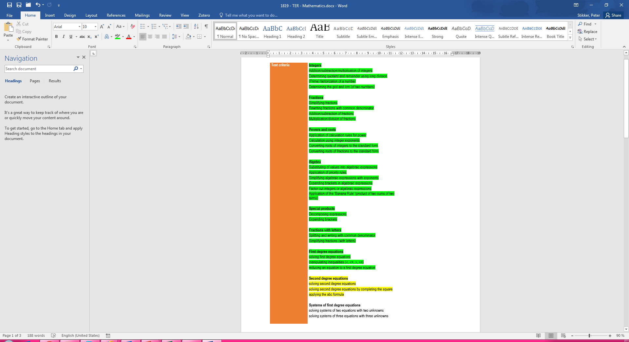
Today
The simple case
Completing the square
The abc-formula

Slide 3
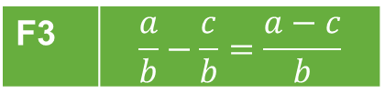
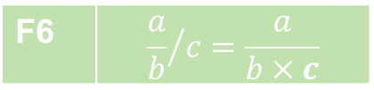


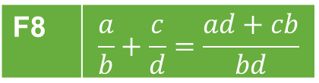
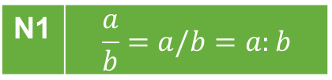
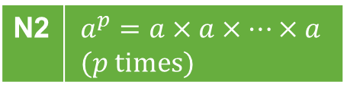

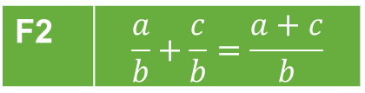
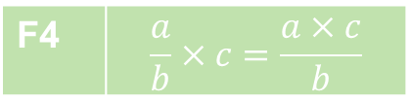

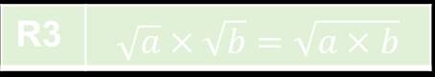

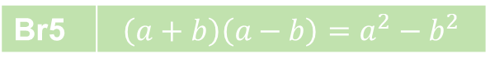







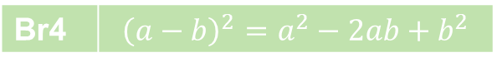

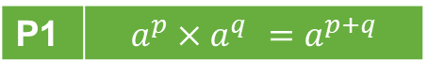

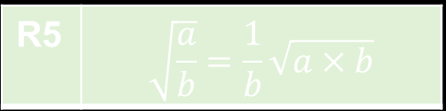
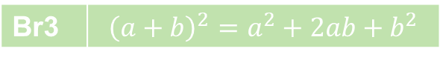

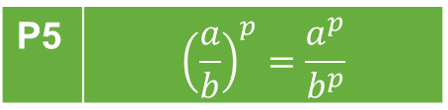
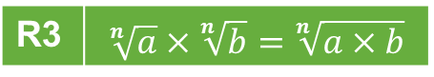
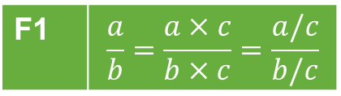
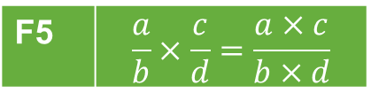
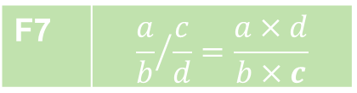

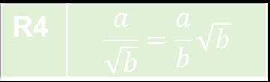

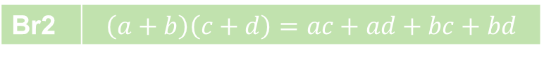
Overview so far…
Power rules
Fraction rules
Notation rules
P1 | $$a^{p}×a^{q} =a^{p+q}$$
F1 | $$\frac{a}{b}=\frac{a×c}{b×c}=\frac{a/c}{b/c}$$
F5 | $$\frac{a}{b}×\frac{c}{d}=\frac{a×c}{b×d}$$
N1 | $$\frac{a}{b}=a/b=a:b$$
P2 | $$a^{p}:a^{q}=a^{p−q}$$
F2 | $$\frac{a}{b}+\frac{c}{b}=\frac{a+c}{b}$$
F6 | $${\frac{a}{b}}/c=\frac{a}{b×c}$$
N2 | $$a^{p}=a×a×…×a \\ (p \text{times})$$
P3 | $${\left(a^{p}\right)}^{q} =a^{p×q}$$
P4 | $${\left(a×b\right)}^{p}=a^{p}×b^{p}$$
F3 | $$\frac{a}{b}−\frac{c}{b}=\frac{a−c}{b}$$
F7 | $${\frac{a}{b}}/{\frac{c}{d}}=\frac{a×d}{b×c}$$
N3 | $$a^{1}=a$$
P5 | $${\left(\frac{a}{b}\right)}^{p}=\frac{a^{p}}{b^{p}}$$
N4 | $$a×b=a∙b=ab$$
F4 | $$\frac{a}{b}×c=\frac{a×c}{b}$$
F8 | $$\frac{a}{b}+\frac{c}{d}=\frac{ad+cb}{bd}$$
N5 | $$\sqrt{a}=\sqrt[2]{a}$$
P6 | $$a^{−p}=\frac{1}{a^{p}}$$
Basic rules
Root rules
Brackets rules
B1 | $$\frac{a}{1}=a$$
R1 | $$\sqrt{a^{2}}=a$$
R1 | $$\sqrt[n]{a^{n}}=a$$
Br1 | $$a\left(b+c\right)=ab+ac$$
R2 | $${\left(\sqrt[n]{a}\right)}^{n}=a$$
B2 | $$\frac{a}{a}=1$$
R2 | $${\left(\sqrt{a}\right)}^{2}=a$$
Br2 | $$\left(a+b\right)\left(c+d\right)=ac+ad+bc+bd$$
R3 | $$\sqrt[n]{a}×\sqrt[n]{b}=\sqrt[n]{a×b}$$
R3 | $$\sqrt{a}×\sqrt{b}=\sqrt{a×b}$$
Br3 | $${\left(a+b\right)}^{2}=a^{2}+2ab+b^{2}$$
B3 | $$a×1=a$$
R4 | $$\frac{a}{\sqrt{b}}=\frac{a}{b}\sqrt{b}$$
Br4 | $${\left(a−b\right)}^{2}=a^{2}−2ab+b^{2}$$
B4 | $$a×b=b×a$$
B5 | $$a+b=b+a$$
R5 | $$\sqrt{\frac{a}{b}}=\frac{1}{b}\sqrt{a×b}$$
Br5 | $$\left(a+b\right)\left(a−b\right)=a^{2}−b^{2}$$

Slide 4
Algorithms, Game Rules
& Formulas
Algorithms
A1: Prime factorization
A2: Divisors
A3: GCD
A4: LCM
A5: Simplify fraction
A6: LCD
A7: Simplify square root
A8: Common Denominator
A9: Simplify fraction with Letters
A10: Completing the square
Game Rules
G1: Rules for equations
G2: Rules for inequalities
Formulas
FO1: abc-Formula

Slide 5
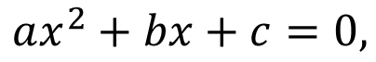
Quadratic equation
from the Latin quadratus for “square"
An equation where the highest power of an unknown is 2. This can always be (re)written into the form:
Where a ≠ 0, and a, b and c are known.
Chapter 10:
Quadratic equations where b = 0 (pg. 78-79)
Completing the square: Quadtratic equations with a = 1 (pg. 80-81)
abc formula: General formula(pg. 82-83)
$$ax^{2}+bx+c=0,$$

Slide 6
Segment 1: The Simple Case

Slide 7
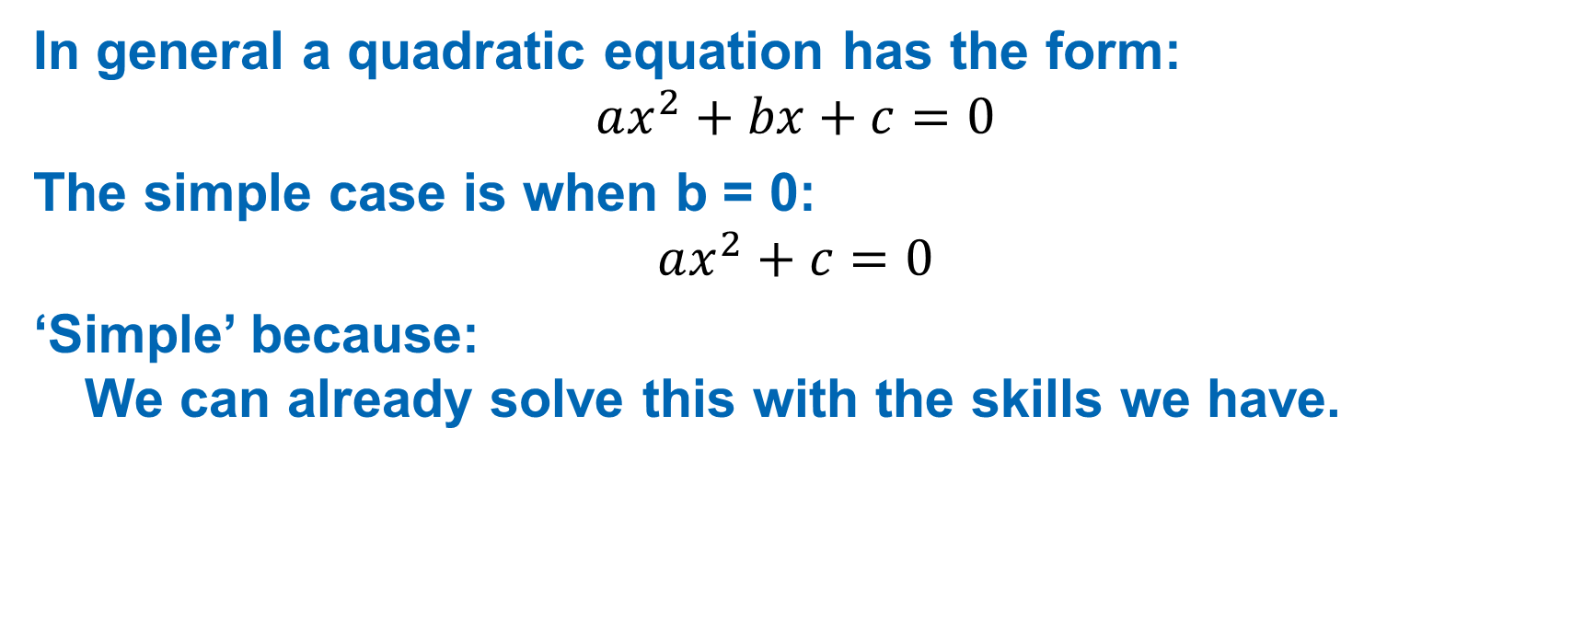
The simple case
In general a quadratic equation has the form: $$ax^{2}+bx+c=0$$
The simple case is when b = 0: $$ax^{2}+c=0$$
‘Simple’ because: We can already solve this with the skills we have.

Slide 8
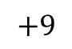
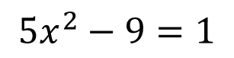
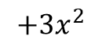
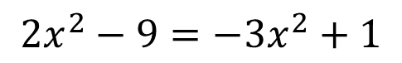
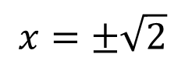
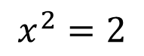
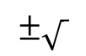
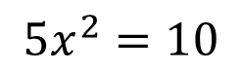
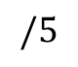
Algorithm & Example
Algorithm if b = 0:
Move everything with x² to the same side
Move everything without x² to the other side
Divide both sides by the coëfficient of x²
Take the square root on both sides
Write the square root in standard form.
$$2x^{2}−9=−3x^{2}+1$$
$$+3x^{2}$$
$$5x^{2}−9=1$$
$$+9$$
$$5x^{2}=10$$
$$/5$$
$$x^{2}=2$$
$$±\sqrt{ }$$
$$x=±\sqrt{2}$$

Slide 9
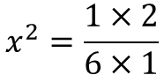
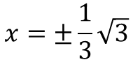
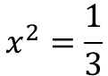
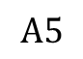
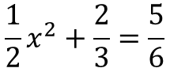
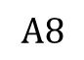
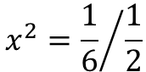
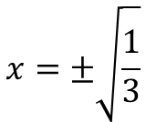
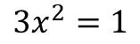
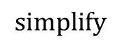
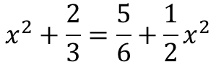
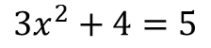
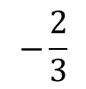
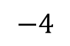
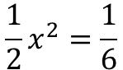
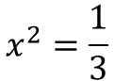
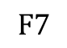
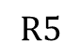













Example 2
$$x^{2}+\frac{2}{3}=\frac{5}{6}+\frac{1}{2}x^{2}$$
$$−\frac{1}{2}x^{2}$$
$$\frac{1}{2}x^{2}+\frac{2}{3}=\frac{5}{6}$$
$$−\frac{2}{3}$$
$$\frac{1}{2}x^{2}=\frac{5}{6}−\frac{2}{3}$$
$$x^{2}+\frac{2}{3}=\frac{5}{6}+\frac{1}{2}x^{2}$$
$$x^{2}=\frac{1}{3}$$
$$×6$$
$$A8$$
$$±\sqrt{ }$$
$$\frac{1}{2}x^{2}=\frac{5}{6}−\frac{4}{6}$$
$$6x^{2}+4=5+3x^{2}$$
$$−3x^{2}$$
$$F3$$
$$x=±\sqrt{\frac{1}{3}}$$
$$3x^{2}+4=5$$
$$−4$$
$$\frac{1}{2}x^{2}=\frac{1}{6}$$
$$/\frac{1}{2}$$
$$R5$$
$$3x^{2}=1$$
$$/3$$
$$x=±\frac{1}{3}\sqrt{3}$$
$$x^{2}=\frac{1}{3}$$
$$x^{2}={\frac{1}{6}}/{\frac{1}{2}}$$
$$F7$$
$$x^{2}=\frac{1×2}{6×1}$$
$$simplify$$
$$x^{2}=\frac{2}{6}$$
$$A5$$
$$x^{2}=\frac{1}{3}$$

Slide 10





Practice
$x^{2}=16$
$x^{2}−15=2x^{2}−2$
$\frac{1}{3}x^{2}−\frac{1}{2}=\frac{1}{4}$
$\left(\frac{1}{2}x+3\right)\left(x−\frac{2}{3}\right)=0$
$$x=−4, x=4$$
$$No solutions$$
$$x=±\frac{3}{2}$$
$$x=−6,x=\frac{2}{3}$$

Slide 11














Answers
$$x^{2}=16$$
$$x^{2}−15=2x^{2}−2$$
$$x=±\sqrt{16}$$
$$x^{2}−x^{2}−15=2x^{2}−x^{2}−2$$
$$x=±\sqrt{4^{2}}$$
$$−15=x^{2}−2$$
$$−15+2=x^{2}−2+2$$
$$x=±4$$
$$−13=x^{2}$$
$$x=−4, x=4$$
$x^{2}$ =$−13$
$$\sqrt{x^{2}}=±\sqrt{−13}$$
$$x=±\sqrt{−13}$$
$$No solutions$$

Slide 12


























Answers
$${\frac{1}{3}x}^{2}−\frac{1}{2}=\frac{1}{4}$$
$$12×\left({\frac{1}{3}x}^{2}−\frac{1}{2}\right)=12×\frac{1}{4}$$
$${4x}^{2}−6=3$$
$${4x}^{2}−6+6=3+6$$
$${4x}^{2}=9$$
$${4x}^{2}=9$$
$$2^{2}x^{2}=3^{2}$$
$$\frac{{4x}^{2}}{4}=\frac{9}{4}$$
$${\left(2x\right)}^{2}=3^{2}$$
$$\sqrt{{\left(2x\right)}^{2}}=±\sqrt{3^{2}}$$
$$x^{2}=\frac{9}{4}$$
$$2x=±3$$
$$\sqrt{x^{2}}=±\sqrt{\frac{9}{4}}$$
$$\frac{2x}{2}=±\frac{3}{2}$$
$$x=±\sqrt{\frac{9}{4}}$$
$$x=±\sqrt{\frac{9}{4}}$$
$$x=±\frac{3}{2}$$
$$x=±\frac{\sqrt{9}}{\sqrt{4}}$$
$$x=±\frac{1}{4}\sqrt{9×4}$$
$$x=±\frac{1}{4}\sqrt{36}$$
$$x=±\frac{\sqrt{3^{2}}}{\sqrt{2^{2}}}$$
$$x=±\frac{1}{4}×\sqrt{6^{2}}$$
$$x=±\frac{1}{4}×6$$
$$x=±\frac{6}{4}$$
$$x=±\frac{3}{2}$$
$$x=±\frac{3}{2}$$

Slide 13










Answers
$$\left(\frac{1}{2}x+3\right)\left(x−\frac{2}{3}\right)=0$$
$$\frac{1}{2}x+3=0$$
$$x−\frac{2}{3}=0$$
$$\frac{1}{2}x+3−3=0−3$$
$$x−\frac{2}{3}+\frac{2}{3}=0+\frac{2}{3}$$
$$\frac{1}{2}x=−3$$
$$x=\frac{2}{3}$$
$$2×\frac{1}{2}x=2×−3$$
$$x=−6$$
$$x=−6,x=\frac{2}{3}$$

Slide 14
Segment 2: Completing the Square

Slide 15















Completing the square origin – part 1/2
Br3 | $${\left(a+b\right)}^{2}=a^{2}+2ab+b^{2}$$
$${\left(x+\frac{b}{2}\right)}^{2}$$
$$=x^{2}+2×x×\frac{b}{2}+{\left(\frac{b}{2}\right)}^{2}$$
$$=x^{2}+bx+{\left(\frac{b}{2}\right)}^{2}$$
$${\left(x+\frac{b}{2}\right)}^{2}$$
$$=x^{2}+bx+{\left(\frac{b}{2}\right)}^{2}$$
$$2×x×\frac{b}{2}$$
B4 | $$a×b=b×a$$
$$−{\left(\frac{b}{2}\right)}^{2}$$
$$=2×\frac{b}{2}×x$$
F4 | $$\frac{a}{b}×c=\frac{a×c}{b}$$
$${\left(x+\frac{b}{2}\right)}^{2}−{\left(\frac{b}{2}\right)}^{2}$$
$$=x^{2}+bx$$
$$=\frac{2×b}{2}×x$$
A9 | Simplify fractions letters
$$=bx$$

Slide 16














Visually
$$x^{2}+bx=−c$$
$$\frac{b}{2}$$
$$x$$
$$b$$
$$x$$
$$x^{2}$$
$$x+\frac{b}{2}$$
$$x$$
$$\frac{b}{2}$$
$$\frac{b}{2}$$
$$\frac{b}{2}$$
$$x+\frac{b}{2}$$
$${\left(x+\frac{b}{2}\right)}^{2}$$
$$−{\left(\frac{b}{2}\right)}^{2}$$

Slide 17









Completing the square origin – part 2/2
Conclusion part 1
$${\left(x+\frac{b}{2}\right)}^{2}−{\left(\frac{b}{2}\right)}^{2}=x^{2}+bx$$
This step is ‘completing the square’, and is the step that has to be shown on the exam
$$x^{2}+bx+c=0$$
Apply conclusion
Part 1
$${\left(x+\frac{b}{2}\right)}^{2}−{\left(\frac{b}{2}\right)}^{2}+c=0$$
$$+{\left(\frac{b}{2}\right)}^{2}−c$$
This we can now always solve.
$${\left(x+\frac{b}{2}\right)}^{2}={\left(\frac{b}{2}\right)}^{2}−c$$
$$±\sqrt{ }$$
$$x+\frac{b}{2}=±\sqrt{{\left(\frac{b}{2}\right)}^{2}−c}$$
$$−\frac{b}{2}$$
$$x=−\frac{b}{2}±\sqrt{{\left(\frac{b}{2}\right)}^{2}−c}$$

Slide 18




















Example 1
$$x^{2}+bx+c=$$
$${\left(x+\frac{b}{2}\right)}^{2}−{\left(\frac{b}{2}\right)}^{2}+c$$
$$x^{2}−6x−16=0$$
$$use completing the square$$
$${\left(x+\frac{−6}{2}\right)}^{2}−{\left(\frac{−6}{2}\right)}^{2}−16=0$$
$$simplify$$
$${\left(x−3\right)}^{2}−{\left(−3\right)}^{2}−16=0$$
$$simplify$$
$${\left(x−3\right)}^{2}−9−16=0$$
$$+25$$
$${\left(x−3\right)}^{2}=25$$
$$±\sqrt{ }$$
$$x−3=±\sqrt{25}$$
$$simplify$$
$$x−3=±5$$
$$+3$$
$$x=3±5$$
$$x=3−5$$
$$x=3+5$$
$$x=−2$$
$$x=8$$

Slide 19















Example 2
$$x^{2}+\frac{3}{2}x−\frac{3}{4}=0$$
$${\left(x+\frac{3}{4}\right)}^{2}=\frac{3^{2}}{4^{2}}+\frac{3×4}{4^{2}}$$
$$x+\frac{3}{4}=±\sqrt{\frac{21}{4^{2}}}$$
$${\left(x+\frac{3/2}{2}\right)}^{2}−{\left(\frac{3/2}{2}\right)}^{2}−\frac{3}{4}=0$$
$${\left(x+\frac{3}{4}\right)}^{2}−{\left(\frac{3}{4}\right)}^{2}−\frac{3}{4}=0$$
$${\left(x+\frac{3}{4}\right)}^{2}=\frac{3^{2}+3×4}{4^{2}}$$
$$x+\frac{3}{4}=±\frac{\sqrt{21}}{\sqrt{4^{2}}}$$
$${\left(x+\frac{3}{4}\right)}^{2}−\frac{3^{2}}{4^{2}}−\frac{3}{4}=0$$
$${\left(x+\frac{3}{4}\right)}^{2}=\frac{9+12}{4^{2}}$$
$$x+\frac{3}{4}=±\frac{\sqrt{21}}{4}$$
$${\left(x+\frac{3}{4}\right)}^{2}=\frac{3^{2}}{4^{2}}+\frac{3}{4}$$
$${\left(x+\frac{3}{4}\right)}^{2}=\frac{21}{4^{2}}$$
$$x=−\frac{3}{4}±\frac{\sqrt{21}}{4}$$
$${\left(x+\frac{3}{4}\right)}^{2}=\frac{3^{2}}{4^{2}}+\frac{3×4}{4^{2}}$$
$$x+\frac{3}{4}=±\sqrt{\frac{21}{4^{2}}}$$

Slide 20




Practice 2
Solve for $x$.
$x^{2}+8x+3=0$
$x^{2}−18x−80=0$
$x^{2}+\frac{5}{2}x+\frac{3}{2}=0$
$$x=−4−\sqrt{13},x=−4+\sqrt{13}$$
$$x=9−\sqrt{161},x=9+\sqrt{161}$$
$$x=−\frac{3}{2},x=−1$$

Slide 21


















Answers worked out
$$x^{2}+8x+3=0$$
$$x^{2}−18x−80=0$$
$${\left(x+\frac{8}{2}\right)}^{2}−{\left(\frac{8}{2}\right)}^{2}+3=0$$
$${\left(x+\frac{−18}{2}\right)}^{2}−{\left(\frac{−18}{2}\right)}^{2}−80=0$$
$${\left(x+4\right)}^{2}−{\left(4\right)}^{2}+3=0$$
$${\left(x−9\right)}^{2}−{\left(−9\right)}^{2}−80=0$$
$${\left(x+4\right)}^{2}−16+3=0$$
$${\left(x−9\right)}^{2}−81−80=0$$
$${\left(x+4\right)}^{2}−13=0$$
$${\left(x−9\right)}^{2}−161=0$$
$${\left(x+4\right)}^{2}=13$$
$${\left(x−9\right)}^{2}=161$$
$$x+4=±\sqrt{13}$$
$$x−9=±\sqrt{161}$$
$$x=−4±\sqrt{13}$$
$$x=9±\sqrt{161}$$
$$x=−4−\sqrt{13},x=−4+\sqrt{13}$$
$$x=9−\sqrt{161},x=9+\sqrt{161}$$

Slide 22






















Answers worked out
$$x^{2}+\frac{5}{2}x+\frac{3}{2}=0$$
$$x+\frac{5}{4}=±\sqrt{\frac{1}{4^{2}}}$$
$${\left(x+\frac{5/2}{2}\right)}^{2}−{\left(\frac{5/2}{2}\right)}^{2}+\frac{3}{2}=0$$
$${\left(x+\frac{5}{4}\right)}^{2}−\frac{25}{4^{2}}+\frac{24}{4^{2}}=0$$
$$x=−\frac{5}{4}±\frac{1}{4}$$
$${\left(x+\frac{5}{4}\right)}^{2}−{\left(\frac{5}{4}\right)}^{2}+\frac{3}{2}=0$$
$${\left(x+\frac{5}{4}\right)}^{2}+\frac{−25+24}{4^{2}}=0$$
$$x+\frac{5}{4}=±\sqrt{\frac{1^{2}}{4^{2}}}$$
$$x=−\frac{5}{4}−\frac{1}{4}$$
$$x=−\frac{5}{4}+\frac{1}{4}$$
$${\left(x+\frac{5}{4}\right)}^{2}−\frac{5^{2}}{4^{2}}+\frac{3}{2}=0$$
$${\left(x+\frac{5}{4}\right)}^{2}+\frac{−1}{4^{2}}=0$$
$$x=−\frac{6}{4}$$
$$x=−\frac{4}{4}$$
$$x+\frac{5}{4}=±\sqrt{{\left(\frac{1}{4}\right)}^{2}}$$
$${\left(x+\frac{5}{4}\right)}^{2}−\frac{5^{2}}{4^{2}}+\frac{3×8}{4^{2}}=0$$
$${\left(x+\frac{5}{4}\right)}^{2}=\frac{1}{4^{2}}$$
$$x=−\frac{3}{2},x=−1$$
$$x+\frac{5}{4}=±\frac{1}{4}$$
$${\left(x+\frac{5}{4}\right)}^{2}−\frac{25}{4^{2}}+\frac{24}{4^{2}}=0$$
$$x+\frac{5}{4}=±\sqrt{\frac{1}{4^{2}}}$$
$$x=−\frac{5}{4}±\frac{1}{4}$$

Slide 23
Segment 3: The abc-formula

Slide 24


The abc formula
$${ax}^{2}+bx+c=0$$
$$x=\frac{−b±\sqrt{b^{2}−4ac}}{2a}$$

Slide 25







abc formula
$${ax}^{2}+bx+c=0$$
$$x=\frac{−b±\sqrt{b^{2}−4ac}}{2a}$$
$$D=b^{2}−4ac$$
$D$=0 => 1 solution
$$x=\frac{−b±\sqrt{D}}{2a}$$
$D$>0 => 2 real solutions
$D$<0 => no real solutions

Slide 26
















Proof: The abc formula
$$x=\frac{−b±\sqrt{b^{2}−4ac}}{2a}$$
$$×2a$$
$$2ax=−b±\sqrt{b^{2}−4ac}$$
$$+b$$
$$2ax+b=±\sqrt{b^{2}−4ac}$$
$$square$$
$${\left(2ax+b\right)}^{2}=b^{2}−4ac$$
Br3 | $${\left(a+b\right)}^{2}=a^{2}+2ab+b^{2}$$
$${\left(2ax\right)}^{2}+2×2axb+b^{2}=b^{2}−4ac$$
P4 | $${\left(a×b\right)}^{p}=a^{p}×b^{p}$$
$$2^{2}a^{2}x^{2}+2×2abx+b^{2}=b^{2}−4ac$$
$$simplify$$
$$4a^{2}x^{2}+4abx+b^{2}=b^{2}−4ac$$
$$−b^{2}$$
$$4a^{2}x^{2}+4abx=−4ac$$
$$/\left(4a\right)$$
$$ax^{2}+bx=−c$$
$$+c$$
$$ax^{2}+bx+c=0$$

Slide 27






















Application abc-formula
$${\frac{2}{5}x}^{2}+\frac{3}{5}x−\frac{5}{4}=0$$
$$a=\frac{2}{5},b=\frac{3}{5},c=−\frac{5}{4}$$
$$D=b^{2}−4ac$$
$$={\left(\frac{3}{5}\right)}^{2}−4×\frac{2}{5}×−\frac{5}{4}$$
$$={\left(\frac{3}{5}\right)}^{2}+\frac{4×2×5}{5×4}$$
$$={\left(\frac{3}{5}\right)}^{2}+2$$
$$=\frac{3^{2}}{5^{2}}+2$$
$$=\frac{3^{2}}{5^{2}}+\frac{2×5^{2}}{5^{2}}$$
$$=\frac{3^{2}+2×5^{2}}{5^{2}}$$
$$=\frac{9+2×25}{25}$$
$$=\frac{9+50}{25}$$
$$=\frac{59}{25}$$
$$x=\frac{−b±\sqrt{D}}{2a}$$
$$=\frac{−\frac{3}{5}±\sqrt{\frac{59}{25}}}{2×\frac{2}{5}}$$
$$=\frac{−\frac{3}{5}±\sqrt{\frac{59}{5^{2}}}}{2×\frac{2}{5}}$$
$$=\frac{−\frac{3}{5}±\frac{\sqrt{59}}{\sqrt{5^{2}}}}{2×\frac{2}{5}}$$
$$=\frac{−\frac{3}{5}±\frac{\sqrt{59}}{5}}{2×\frac{2}{5}}$$
$$=\frac{\frac{−3±\sqrt{59}}{5}}{\frac{2×2}{5}}$$
$$=\frac{\frac{−3±\sqrt{59}}{5}}{\frac{4}{5}}$$
$$=\frac{\left(−3±\sqrt{59}\right)×5}{4×5}$$
$$=\frac{−3±\sqrt{59}}{4}$$
$$=−\frac{3}{4}±\frac{\sqrt{59}}{4}$$

Slide 28


















If you don’t like fractions…
$${\frac{2}{5}x}^{2}+\frac{3}{5}x−\frac{5}{4}=0$$
$$×20$$
$${8x}^{2}+12x−25=0$$
$$a=8,b=12,c=−25$$
$$D=b^{2}−4ac$$
$$={12}^{2}−4×8×−25$$
$$=144+800$$
$$=944$$
$$x=\frac{−b±\sqrt{D}}{2a}$$
$$=\frac{−12±\sqrt{944}}{2×8}$$
$$=\frac{−12±\sqrt{2×2×2×2×59}}{2×8}$$
$$=\frac{−12±\sqrt{2^{2}×2^{2}×59}}{2×8}$$
$$=\frac{−12±\sqrt{2^{2}}\sqrt{2^{2}}\sqrt{59}}{2×8}$$
$$=\frac{−12±2×2×\sqrt{59}}{2×8}$$
$$=\frac{−12±4\sqrt{59}}{16}$$
$$=\frac{4\left(−3±\sqrt{59}\right)}{4×4}$$
$$=\frac{−3±\sqrt{59}}{4}$$
$$=−\frac{3}{4}±\frac{\sqrt{59}}{4}$$

Slide 29




Practice 3
$x^{2}+3x+1=0$
${3x}^{2}+2x+1=0$
${\frac{2}{3}x}^{2}+2x−3=0$
$$x=−\frac{3}{2}±\frac{1}{2}\sqrt{5}$$
$$No solutions$$
$$x=−\frac{3}{2}±\frac{3}{2}\sqrt{3}$$

Slide 30











Answers
$$x^{2}+3x+1=0$$
$${3x}^{2}+2x+1=0$$
$$x_{1,2}=\frac{−3±\sqrt{3^{2}−4×1×1}}{2×1}$$
$$x_{1,2}=\frac{−2±\sqrt{2^{2}−4×3×1}}{2×3}$$
$$x_{1,2}=\frac{−3±\sqrt{9−4}}{2}$$
$$x_{1,2}=\frac{−2±\sqrt{4−12}}{6}$$
$$x_{1,2}=\frac{−3±\sqrt{5}}{2}$$
$$x_{1,2}=\frac{−2±\sqrt{−8}}{6}$$
$$x_{1,2}=−\frac{3}{2}±\frac{\sqrt{5}}{2}$$
$$No solutions$$
$$x_{1,2}=−\frac{3}{2}±\frac{1}{2}\sqrt{5}$$

Slide 31




















Answers
$${\frac{2}{3}x}^{2}+2x−3=0$$
$${\frac{2}{3}x}^{2}+2x−3=0$$
$$3×\left({\frac{2}{3}x}^{2}+2x−3\right)=3×0$$
$$x_{1,2}=\frac{−2±\sqrt{2^{2}−4×\frac{2}{3}×\left(−3\right)}}{2×\frac{2}{3}}$$
$${2x}^{2}+6x−9=0$$
$$x_{1,2}=\frac{−6±\sqrt{6^{2}−4×2×\left(−9\right)}}{2×2}$$
$$x_{1,2}=\frac{−2±\sqrt{4+8}}{\frac{4}{3}}$$
$$x_{1,2}=\frac{−6±\sqrt{36+72}}{4}$$
$$x_{1,2}=\frac{−2±\sqrt{12}}{\frac{4}{3}}$$
$$x_{1,2}=\frac{−6±\sqrt{108}}{4}$$
$$x_{1,2}=\frac{−2±\sqrt{2^{2}×3}}{\frac{4}{3}}$$
$$x_{1,2}=−\frac{6}{4}±\frac{\sqrt{108}}{4}$$
$$x_{1,2}=\frac{−2±2\sqrt{3}}{\frac{4}{3}}$$
$$x_{1,2}=−\frac{6}{4}±\frac{\sqrt{2^{2}×3^{2}×3}}{4}$$
$$x_{1,2}=−\frac{6}{4}±\frac{2×3×\sqrt{3}}{4}$$
$$x_{1,2}=\frac{3×\left(−2±2\sqrt{3}\right)}{4}$$
$$x_{1,2}=−\frac{6}{4}±\frac{6}{4}\sqrt{3}$$
$$x_{1,2}=\frac{−6±6\sqrt{3}}{4}$$
$$x_{1,2}=−\frac{3}{2}±\frac{3}{2}\sqrt{3}$$
$$x_{1,2}=−\frac{6}{4}±\frac{6}{4}\sqrt{3}$$

Slide 32
Closure
Overview & H☺mew☹rk

Slide 33

NOT for the exam
3rd degree formula? Formula of Cardano
For 4th degree there is also a formula.
For 5th and higher Abel proved there is NO (algebraic) formula.

Slide 34













Bonus Puzzle 2
$$x^{2}+x+1=0$$
$$x+1=−x^{2}$$
$$x^{2}+x=−1$$
$$x\left(x+1\right)=−1$$
$$x\left(−x^{2}\right)=−1$$
$$−x^{3}=−1$$
$$x^{3}=1$$
$$x=1$$
$$x^{2}+x+1=0$$
$$x=1$$
$$1^{2}+1+1=0$$
$$1+1+1=0$$
$$3=0$$

Slide 35









Bonus: Alternative for abc-formula
$$x=\frac{2c}{−b±\sqrt{b^{2}−4ac}}$$
$$x\left(−b±\sqrt{b^{2}−4ac}\right)=2c$$
$$−bx±x\sqrt{b^{2}−4ac}=2c$$
$$±x\sqrt{b^{2}−4ac}=2c+bx$$
$$x^{2}\left(b^{2}−4ac\right)={\left(2c+bx\right)}^{2}$$
$b^{2}x^{2}−4acx^{2}={\left(2c\right)}^{2}+\left(2×2c×bx\right)$+ ${\left(bx\right)}^{2}$
$$b^{2}x^{2}−4acx^{2}=4c^{2}+4bcx+b^{2}x^{2}$$
$$−4acx^{2}=4c^{2}+4bcx$$
$$−ax^{2}=c+bx$$
$$0=ax^{2}+bx+c$$

Slide 36

H☺me W☹rk
Theory: Chapter 10: pg. 78-83
Selected exercises: pg. 78: 10.1(a,c,e) 10.2(a,c,e) 10.3(a,c,e) 10.4(a,c,e) 10.5(a,c,e) 10.6(a,c,e) 10.7(a,c,e) 10.8(a,b,c) pg. 80: 10.11(a,c,e) 10.14(a,c,e) 10.15(a,c,e) 10.16(a,c,e) pg. 82: 10.17(a,c,e) 10.18(a,c,e) 10.21(a,c,e) 10.23(a,c,e) 10.25 (a,c,e) 10.26(a,c,e)

